Slide 1
Three-Way Short Text Neural Network Sentiment Classification Model
Kurt Harris
2021

Slide 2
Brief Introduction About Myself
Manager of Data Analytics for a fortune 50 company
Working with data and analytics for the last 7 years
Experienced in: A|B trials, sentiment & topic models, correlation, clustering, variance and trend analyses
BS in Software, completing a Masters in Data Analytics
Core tools: Python, Tableau and SQL

Slide 3
Problem and Hypothesis
Problem: understanding the quality of a customer interaction with a service department is historically based on a post survey response, leaving little room for proactive outreach and prevention of churn. The lack of insight into customer interactions leads to undue churn that might have been prevented.
Question: Can the sentiment of a short statement from be accurately predicted as positive, neutral or negative?
Hypothesis: A predictive sentiment model can be created with accuracy above 70%. The null hypothesis is that one can not be created above said threshold.

Slide 4
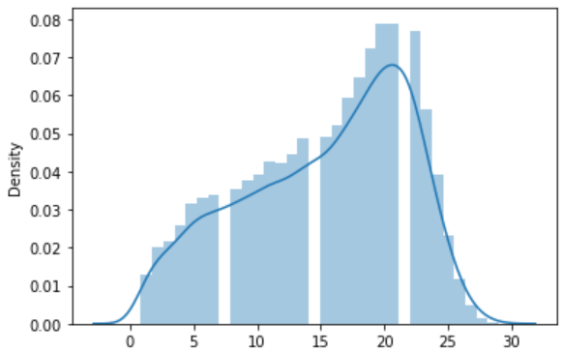
Summary of Data Analysis
Data gathered from Kaggle.com, free and public (Twitter US Airline Sentiment, 2019)
Data is cleaned with spelling corrections, lower-case character conversions and removal of null or empty values
Distribution plot of text lengths shows a max length of 30 words will capture all our data and some padding will be needed on shorter text
Split into train and test sets roughly 90/10%

Slide 5
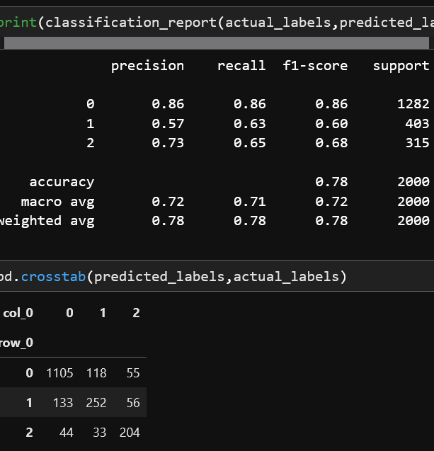
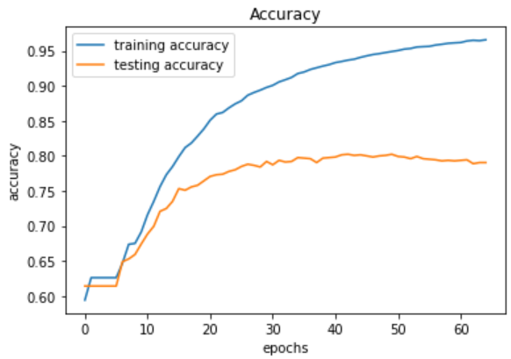
Findings
Accuracy on the test sample is near 80%
P-value results from ANOVA analysis, a commonly used test on results, confirms our accuracy isn’t random chance (Python for Data Science, 2020)
Alternative hypothesis is accepted

Slide 6

Limitations of Techniques and Tools
A limitation to this model is that it requires the use of tensors, arrays of data that must be the same size and shape. This model is specific to short text and might not be as accurate on longer text lengths (Virahonda, 2020).

Slide 7
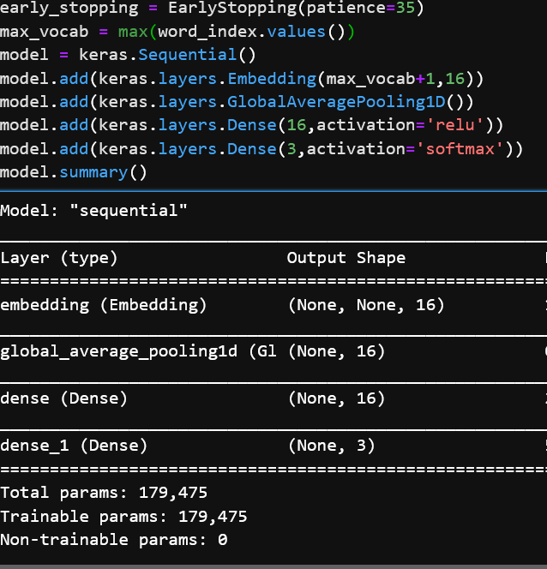
Proposed Actions
Additional testing on other types of short text like SMS or online chat is necessary to understand the model’s accuracy generally on short text
Tweaks to the model architecture with new data could improve accuracy like adding additional hidden layers or nodes to the model.

Slide 8



Expected Benefits
Proactive customer outreach when negative sentiment is predicted could help reduce churn and improve the customer experience
Additional analyses could be conducted using the model’s predictions to cluster the most painful topics based on negative sentiment. This would help identify some of the biggest customer experience opportunities to help further reduce churn.

Slide 9
References
Virahonda, Sergio (2020, October 8). Sentiment Analysis with Deep Learning and Keras Retrieved November 17, 2021, from
https://towardsdatascience.com/an-easy-tutorial-about-sentiment-analysis-with-deep-learning-and-keras-2bf52b9cba91
Python for Data Science, LLC (2020) Retrieved November 23rd, 2021, from
https://www.pythonfordatascience.org/anova-python/
Twitter US Airline Sentiment (2019, October 19). Retrieved November 5, 2021 from
https://www.kaggle.com/crowdflower/twitter-airline-sentiment

